Slide 1
Chapter 3- Biopsychology

Slide 2
Agenda
Human Genetics
Cells of the Nervous System
Parts of the Nervous System
Class Activity

Slide 3
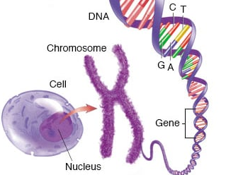
Genetics: The Nuts and Bolts
Chromosome- “X” shaped bundles of genetic material called DNA
DNA (deoxyribonucleic acid)- the blueprints detailing all the genetic information for a person
Gene- a sequence of DNA responsible for specific traits (e.g., hair color, eye color, etc.)
Allele- a specific version of a gene. For example, the gene for hair color could have blonde alleles.

Slide 4
How are Genes Expressed?
Each person receives half of their DNA from their mother and half of their DNA from their father. These traits can be evaluated on two levels:
Genotype- the genetic combination of traits from parents
Phenotype- the physical appearance of the traits being expressed
But how does your body pick which traits are expressed? It matters if that allele is dominant or recessive.
Dominant allele- This allele for a gene has a stronger chance of being expressed (ex: brown eyes)
Recessive allele- This allele for a gene has a weaker chance of being expressed (ex: blue eyes)
How do these alleles blend from two different parents?
Homozygous- When the parents each have the same trait that is passed on
Heterozygous- When the parents have different traits, creating a blend. The dominant allele will “win” expression

Slide 5
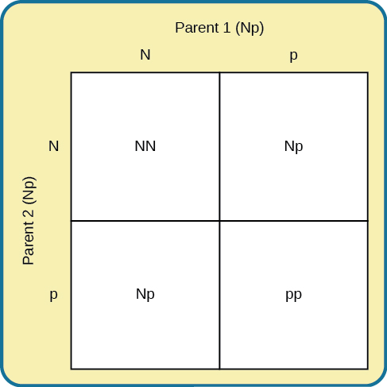
The Punnett Square
Each parent is heterozygous for the trait (we will use eye color, where brown is dominant, and blue is recessive)
25% Chance of homozygous brown genotype (phenotype expressed= brown)
50% Chance of heterozygous brown genotype (phenotype expressed= brown)
25% Chance of homozygous blue genotype (phenotype expressed= blue)

Slide 6
How Does Genetics Relate to Psychology?
According to Charles Darwin’s theory of evolution by natural selection, the environment controls which genes continue to another generation by favoring traits that help with survival
Mutation- when genes are permanently changed, which may help or hinder the individual in that particular environment (ex: sickle cell anemia and malaria)
Range of reaction- Genes give a range of possibilities (such as a certain capacity for intelligence) while the environment dictates where on the range an individual will fall
Genetic environmental correlation- the interaction between genes and environment have an impact in both directions (ex: children born to athletic parents)
Epigenetics- a field of study centered around how genotypes can be expressed in completely different ways based on their environment (ex: identical twins adopted by different parents)

Slide 7
How Do Genes Interact with Our Environment?
Genetics can impact behavioral characteristics such as personality traits or personal preferences
Many psychological disorders are a blend of genetic and environmental factors.
We cannot accurately address psychology without understanding the genetic roots for many topics

Slide 8
The Nervous System

Slide 9
The Nervous System
The nervous system is the relay system for the body, passing messages to and from the brain
Neuron- the main type of cell in the nervous system, which is responsible for the passing of communication
Glial cells- the “assistants” of neurons, helping to provide structure, nutrients, and other basic needs
Neurotransmitters- chemical messengers passed between neurons

Slide 10

The Neuron
Function: Contain genetic information; drive activity

Slide 11
The Neuron
Function: Receive and process signals (aka neurotransmitters)

Slide 12
The Neuron
Function: Axons pass signals, releasing neurotransmitters from axon terminals

Slide 13
The Neuron
Function: Insulates axon; prevents electrical signals from escaping (creates faster signals)
White Matter: neural tissue that is myelinated; usually involved in signal transmission
Gray Matter: neural tissue that is unmyelinated; brain functions

Slide 14
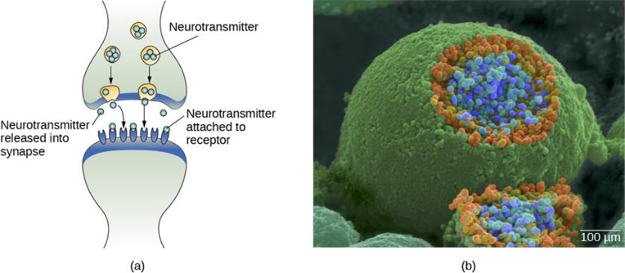
The Synaptic Cleft

Slide 15
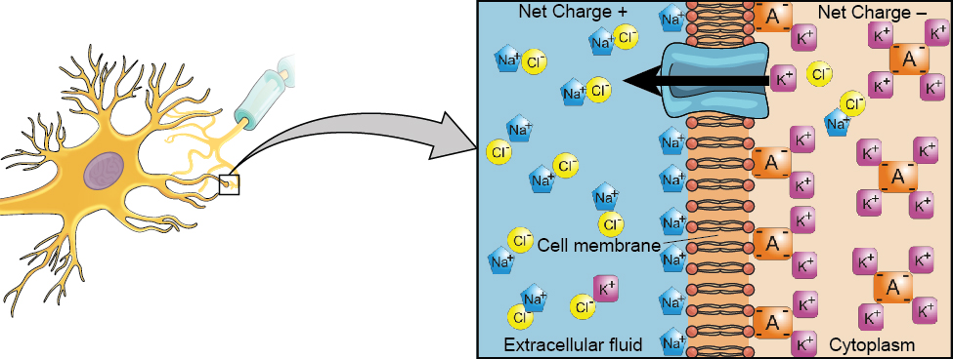
Steps of Communication Between Neurons
Steps:
Resting
Depolarization
Action Potential Generated
Repolarization

Slide 16
This process occurs for every communication between neurons, spurring everything from clenching a muscle to considering a memory. This electrical messaging system is used at every level of the nervous system.

Slide 17
The Spinal Cord
The spinal cord serves as the relay station to the brain, and all messages must travel up the cord to reach the brain.
Acting as a second-in-command to the brain, the spinal cord can send responses to basic stimuli. These reflexes occur faster because the spinal cord is controlling the response, rather than the message travelling up to the brain and back.
Nervous tissue does not heal as well as other tissues like seen in the skin or muscles. When injuries to nervous tissue do occur, the system will rewrite itself to send messages through the remaining healthy neurons. This ability to change and adapt is known as neuroplasticity.

Slide 18
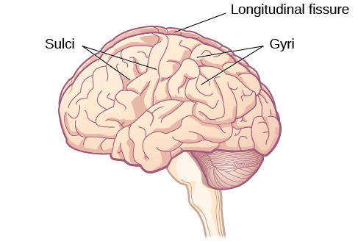
Major Divisions of the Brain: Split the Hemispheres
The brain can be split in half down the middle line, known as the longitudinal fissure. These two halves (the left and right hemisphere) are connected by the corpus callosum, a think band of fibers that facilitates communication between the hemispheres.
Lateralization: the specialization in function in each hemisphere. Each hemisphere controls the opposite side of the body (the left side of the brain controls the right half of the body, and vice versa). Hence, a stroke on the left side of the brain results in difficulty using the right side of the body.

Slide 19
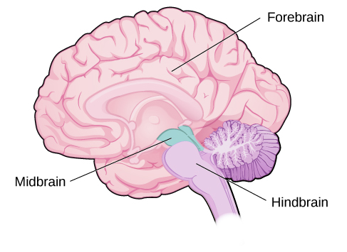
Major Divisions of the Brain: The Forebrain, Midbrain, and Hindbrain

Slide 20
The Forebrain
Includes the cerebral cortex, thalamus, hypothalamus, pituitary gland, and the limbic system.
Cerebral cortex: associated with higher processes such as thought, emotion, language, and memory. Each cerebral hemisphere can be broken into 4 lobes, each having different functions.
Thalamus: acts as a relay for all the senses except smell
Pituitary Gland: regulates hormones (important for growth, reproduction, blood pressure, etc.)
Limbic System: processes emotion and memory, and the sense of smell (this is combination is why smells can trigger memories in a way the other senses cannot). Includes the hippocampus, amygdala, and hypothalamus.

Slide 21
The Midbrain
The midbrain contains the majority of the reticular formation (it extends into both the forebrain and hindbrain), which regulates the sleep/wake cycle, arousal, alertness, and motor activity.
The midbrain also contains the substantia nigra and the ventral tegmental area (VTA), regions associated with dopamine production, movement, mood, reward, and addiction. The degeneration of theses regions are involved in Parkinson’s disease.

Slide 22
The Hindbrain
The hindbrain contains the cerebellum and regions of the brainstem known as the medulla and pons
Cerebellum: receives messages from muscles, tendons, joints, and structures in our ear to control balance, coordination, movement, and motor skills. The cerebellum also aids in procedural memory (muscle memory).
Medulla (medulla oblongata): controls the automatic processes of the autonomic nervous system such as breathing, blood pressure, and heart rate
Pons: connects the hindbrain to the rest of the brain, and is involved in regulating brain activity during sleep

Slide 23
Labeling the Brain

Slide 24
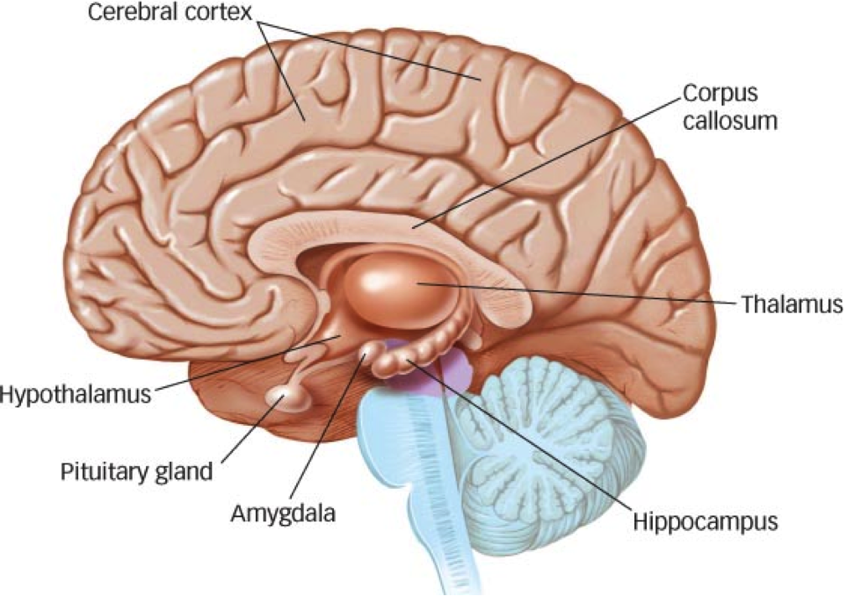
The Brain
Function: Facilitates communication between left and right hemispheres

Slide 25
The Brain
Function: Recognition of stimuli; relay impulses

Slide 26
The Brain
Function: Movement and balance
Cerebellum

Slide 27
The Brain
Function: Converts short-term memory to long-term memory

Slide 28
The Brain
Function: Regulates essential life functions (breathing, blood pressure, etc.)
Medulla

Slide 29
The Brain
Function: Relay between parts of brain; helps regulate basic functions (facial movements, blinking, digesting, etc.)
Pons

Slide 30
The Brain
Function: Emotional processing; connects emotions and memory

Slide 31
The Brain
Function: Produces and releases hormones

Slide 32
The Brain
Function: Produces and releases hormones, particularly those involved in the autonomic nervous system

Slide 33
The Brain
Function: Higher-order processing, intelligence, memory, and personality

Slide 34
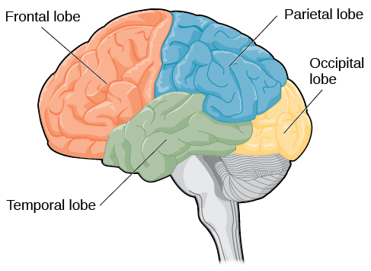
Lobes of the Brain
Frontal Lobe
-Involved in reasoning, motor control, emotion, and language
-Contains the motor cortex (movement coordination), prefrontal cortex (higher-level cognitive function), and Broca’s area (language production)
Parietal Lobe
-Involved in processing information from the body’s senses
-Contains the somatosensory cortex (sensory information such as touch, temperature, and pain)
Temporal Lobe
-Associated with hearing, memory, emotion, and some aspects of language
-Contains the auditory cortex (processes sounds) and Wernicke’s area (speech comprehension)
Occipital Lobe
-Associated with processing vision and mental representation
-Contains the primary visual cortex (interpreting incoming vision)

Slide 35
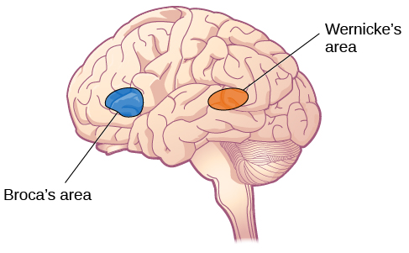
Individuals with damage to Wernicke’s area can produce sensible language, but struggle to understand it
Individuals with damage to Broca’s area can understand language but struggle to produce words, spoken or written

Slide 36

Damage to Broca’s Area

Slide 37

Damage to Wernicke’s Area

Slide 38
Technology for Studying the Brain
Computerized tomography (CT) scan: This scan takes x-rays that show different densities of material, which is often used to determine if someone has a tumor or significant brain atrophy.
Positron emission tomography (PET) scans: This scan uses radioactive material attached to a sugar, which flows through a person’s blood stream. Active areas “eat” the sugar, and the attached radioactive material lights up like a beacon on the scan, showing which areas are active.
Magnetic resonance imaging (MRI): A magnetic field is used to make the hydrogen atoms in a person move. When the field is turned off, the hydrogen atoms give off signals as they return to their original position. Different tissues give different signals, which are displayed on a monitor.
Functional magnetic resonance imaging (fMRI): These scans are similar to an MRI, but also includes blood flow and oxygen tracking over a span of time.
Electroencephalography (EEG): Electrodes attached to a person’s head measure the brain’s electrical activity, including both frequency and amplitude of the recorded brainwaves.

Slide 39
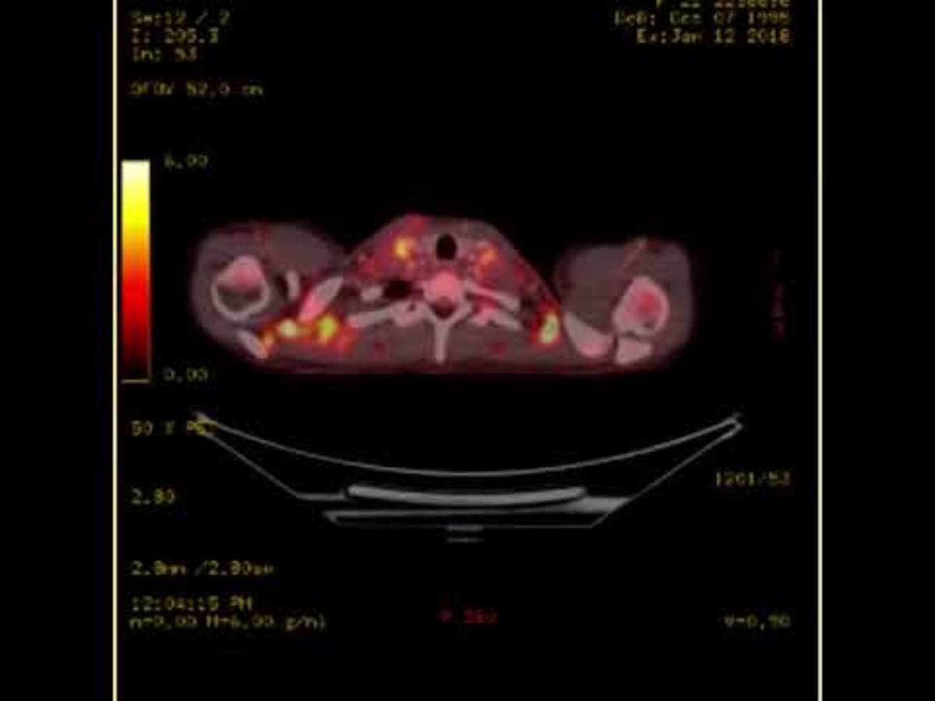
PET Scan

Slide 40
We’ve discussed how the body can send messages with neurotransmitters. Are there any other ways the body sends messages?
Yes! With hormones!

Slide 41
The Endocrine System
The endocrine system sends chemical messengers called hormones throughout the body, helping regulate numerous bodily functions.
What makes hormones different than neurotransmitters?
1. Hormones are released into the bloodstream, passing the message to the entire body, rather than staying in one local area.
2. Hormones are much slower to take effect but tend to be longer lasting.
Hormones are released from glands throughout the body, with different glands and hormones having different functions.

Slide 42
Major Endocrine Glands and Hormones
Endocrine Gland | Associated Hormones | Function
Pituitary | Growth hormone, releasing and inhibiting hormones (such as thyroid stimulating hormone) | Regulate growth, regulate hormone release
Thyroid | Thyroxine, triiodothyronine | Regulate metabolism and appetite
Pineal | Melatonin | Regulate some biological rhythms such as sleep cycles
Adrenal | Epinephrine, norepinephrine | Stress response, increase metabolic activities
Pancreas | Insulin, glucagon | Regulate blood sugar levels
Ovaries | Estrogen, progesterone | Mediate sexual motivation and behavior, reproduction
Testes | Androgens, such as testosterone | Mediate sexual motivation and behavior, reproduction

Slide 43
Next Time on PSY 203…
Before Next Class:
Read Chapter 8
Take Chapter 8 Quiz
Due 2/3 at 11:59 pm
Next Class:
Chapter 8- Memory

